Slide 1
Data-types and operators
Zainab Shahzadi

Slide 2
Simple Data Types
Three categories of simple data
Integral: integers (numbers without a decimal)(45)
Floating-point: decimal numbers (45.56)
character type: characters (AZ, a-z, 0-9 etc.)
data types are further classified into nine categories:
char, short, int, long, bool
unsigned char, unsigned short, unsigned int, unsigned long

Slide 3
Simple Data Types (cont'd.)
Different compilers may allow different ranges of values

Slide 4
bool Data Type
bool type
Two values: true and false
Manipulate logical (Boolean) expressions
true and false
Logical values
bool, true, and false
Reserved words

Slide 5
char Data Type
The smallest integral data type
Used for characters: letters, digits, and special symbols
Each character is enclosed in single quotes
'A', 'a', '0', '*', '+', '$', '&'
A blank space is a character
Written ' ', with a space left between the single quotes
‘abc’ and ‘!=‘ are not char
ASCII character set represent a different character

Slide 6
Floating-Point Data Types
You may be familiar with scientific notation. For example:
43872918 = 4.3872918 * 107 {10 to the power of seven}
.0000265 = 2.65 * 10-5 {10 to the power of minus five}
47.9832 = 4.79832 * 101 {10 to the power of one}

Slide 7
Floating-Point Data Types
C++ uses scientific notation to represent real numbers (floating-point notation)

Slide 8
Floating-Point Data Types (cont'd.)
float: represents any real number
Range: -3.4E+38 to 3.4E+38 (four bytes)
double: represents any real number
Range: -1.7E+308 to 1.7E+308 (eight bytes)

Slide 9
Floating-Point Data Types (cont'd.)
Maximum number of significant digits (decimal places) for float values is 6 or 7
Maximum number of significant digits for double is 15
Precision: maximum number of significant digits
Float values are called single precision
Double values are called double precision

Slide 10
Data type and variables
When we declare a variable we not only specify the variable we also specify what type of data a variable can store. A syntax rule to declare a variable datatype identifier;
For example consider the following examples:
int counter;
Bool var;
double interestRate;
char grade;

Slide 11
Type | Width | Common Range
char | 8 | -128 to 127
unsigned char | 8 | 0 to 255
int | 32 | –2,147,483,648 to 2,147,483,647
unsigned int | 32 | 0 to 4,294,967,295
short int | 16 | -32768 to 32767
unsigned short int | 16 | 0 to 65535
long int | 64 | -2,147,483,648 to 2,147,483,647
unsigned long int | 64 | 0 to 4,294,967,295
float | 32 | 3.4E-38 to 3.4E+38
double | 64 | 1.7E-308 to 1.7E+308
long double | 80 | 3.4E-4932 to 3.4E+4932

Slide 12
Arithmetic Operators
C++ arithmetic operators:
+ addition
- subtraction
* multiplication
/ division
% modulus operator
+, -, *, and / can be used with integral and floating-point data types
Operators can be unary or binary

Slide 14
Example

Slide 15
Example—Contd..

Slide 16
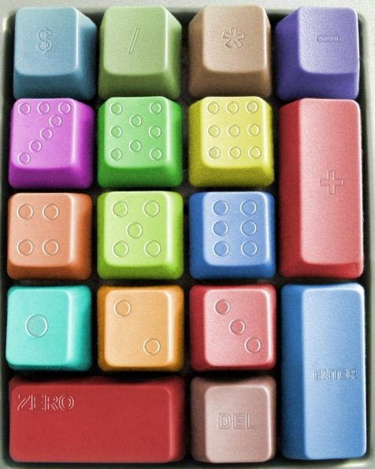
C++ Math Operator Rules
* : Multiplication
/ : Division
Integer division truncates remainder
7 / 5 evaluates to 1
% : Modulus operator returns remainder
7 % 5 evaluates to 2
+ : Addition
_ : Subtraction

Slide 17
Order of Precedence
All operations inside of () are evaluated first
*, /, and % are at the same level of precedence and are evaluated next
+ and – have the same level of precedence and are evaluated last
When operators are on the same level
Performed from left to right (associativity)
3 * 7 - 6 + 2 * 5 / 4 + 6 means
(((3 * 7) – 6) + ((2 * 5) / 4 )) + 6

Slide 18
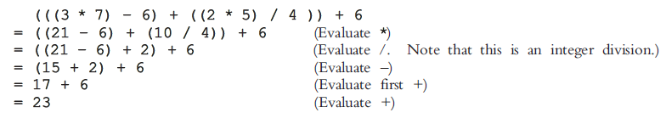
Example

Slide 19
Example

Slide 20
Expressions
If all operands are integers
Expression is called an integral expression
Yields an integral result
Example: 2 + 3 * 5
If all operands are floating-point
Expression is called a floating-point expression
Yields a floating-point result
Example: 12.8 * 17.5 - 34.50

Slide 21
Examples
Consider the following C++ integral expressions:
2 + 3 * 5
3 + x - y / 7
x + 2 * (y - z) + 18
In these expressions, x, y, and z represent variables of the integer type; that is, they can hold integer values.

Slide 22
Mixed Expressions
Mixed expression:
Has operands of different data types
Contains integers and floating-point
Examples of mixed expressions:
2 + 3.5
6 / 4 + 3.9
5.4 * 2 – 13.6 + 18 / 2

Slide 23
Mixed Expressions (cont'd.)
Evaluation rules: Rule # 1
If operator has same types of operands
Evaluated according to the type of the operands
If operator has both types of operands
Integer is changed to floating-point with decimal part “0”
Operator is evaluated
Result is floating-point
Rule # 2
Entire expression is evaluated according to precedence rules

Slide 24
Example – I
#include <iostream>
using namespace std;
int main(){
cout << "5.0 + 3.5 = " << 5.0 + 3.5 << endl;
cout << "3.0 + 9.4 = " << 3.0 + 9.4 << endl;
cout << "16.3 - 5.2 = " << 16.3 - 5.2 << endl;
cout << "4.2 * 2.5 = " << 4.2 * 2.5 << endl;
cout << "5.0 / 2.0 = " << 5.0 / 2.0 << endl;
cout << "34.5 / 6.0 = " << 34.5 / 6.0 << endl;
cout << "34.5 / 6.5 = " << 34.5 / 6.5 << endl;
return 0;
}

Slide 25
Type Conversion (Casting)
Implicit type coercion: when value of one type is automatically changed to another type
2 + 3.4 = 2.0 + 3.4 = 5.4
int num1;
float num2 = 12.45;
num1 = num2;
num1 = ?
Cast operator: provides explicit type conversion
static_cast<dataTypeName>(expression)
Notes:
Num1 = 12

Slide 26
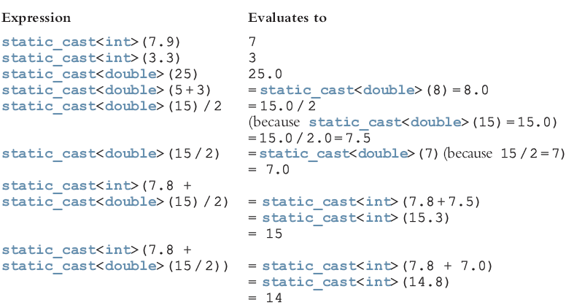
Type Conversion (cont'd.)
Notes:
Short way (int)(3.4)

Slide 27
Allocating Memory with Constants and Variables
Storing data in the computer’s memory is a two-step process:
1. Instruct the computer to allocate memory.
2. Include statements in the program to put data into the allocated memory.

Slide 28

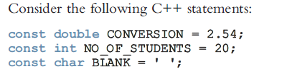
Contd..
Named constant: A memory location whose content is not allowed to change during program execution.
To allocate memory, we use C++’s declaration statements. The syntax to declare a named constant is:

Slide 29

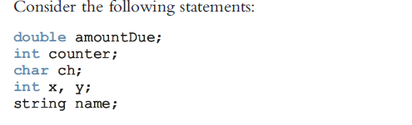
Variable
Variable: A memory location whose content may change during program execution. The syntax for declaring one variable or multiple variables is:

